Slide 1


Gerard Toonstra| Data Discovery with Amundsen | 27-11-2019

Slide 2
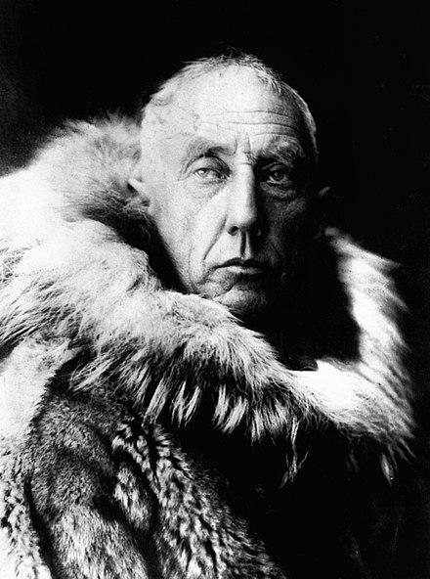
Amundsen who?
Roald Amundsen (1872-1928)
Norwegian arctic explorer
First to explore South Pole
First to traverse NW passage by sea

Slide 3


Slide 4
Decentralization and democratization of data is not productive unless you use tools that allow you to make sense of the plethora of data products you never knew you were going to have.

Slide 5

Data discovery issues
Analysis of price elasticity for MacBooks

Slide 6
Data discovery issues
→ Question #1: Where is the data for sales and product prices by date?

Slide 7
Data discovery issues
→ Question #1: Where is the data for sales and product prices by date?
→ Question #2: Is the data current and actively monitored?

Slide 8
Data discovery issues
→ Question #1: Where is the data for sales and product prices by date?
→ Question #2: Is the data current and actively monitored?
→ Question #3: Does the “price” column include or exclude VAT?

Slide 9
Data discovery issues
→ Question #1: Where is the data for sales and product prices by date?
→ Question #2: Is the data current and actively monitored?
→ Question #3: Does the “price” column include or exclude VAT?
→ Question #4: Is it the actual “sales price” or is it list price?

Slide 10

Data discovery issues
Redesigning, relocating and deprecating data products

Slide 11
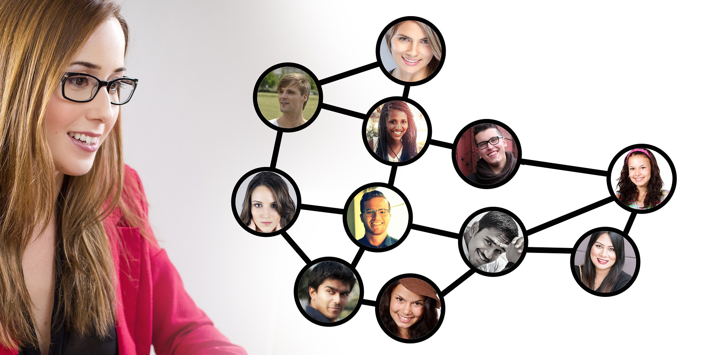
Data discovery issues
Finding other users of the same data (inspiration, innovation, sharing)

Slide 12



Side effects
uncertainty
Increased load
and query cost
interruptions
Does data exist?
Prior work?
Source of truth?
Who owns it?
Who uses it?
Lots of queries like:
SELECT
*
FROM
default.my_table
WHERE ds=’2018-01-01’
LIMIT 100;
No way to know & understand trusted data
Created channels & oncalls for data questions

Slide 13
Metadata is key to next bigdata wave
Discover new data sources
Identify end users to notify them of changes
Understand the popularity and trustworthiness of data
Network with other people on their data analysis
Investigate/monitor the magnitude of protected data exposure
Know what your boss or colleagues are using
Talk to upstream producers
+30% productivity for data scientists

Slide 14
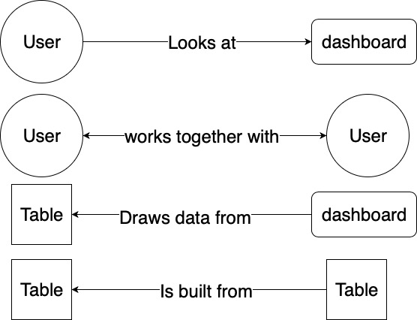
It’s all about relationships

Slide 15
ABC of metadata
Application Context
Metadata needed by humans or applications to operate
Where is the data?
What are the semantics of the data?

Slide 16
ABC of metadata
Application Context
Metadata needed by humans or applications to operate
Where is the data?
What are the semantics of the data?
Behavior
How is data created and used over time?
Who’s using the data?
Who created the data?

Slide 17
ABC of metadata
Application Context
Metadata needed by humans or applications to operate
Where is the data?
What are the semantics of the data?
Behavior
How is data created and used over time?
Who’s using the data?
Who created the data?
Change
Change in data over time
How is the data evolving over time?
Evolution of code that generates the data
Terminology: Ground paper
from Berkeley

Slide 18
What’s out there?
Vendors - Alation, Collibra
Existing open source projects (e.g. Apache Atlas, Marquez)
LinkedIn’s data portal - Wherehows & DataHub (blog, code)
Twitter’s data discovery (blog)
Netflix’s metacat (code, blog)
Airbnb’s data portal (blog, video)
Big Query SQL Web UI & data catalog (blog)
Goods: Organizing Google’s Datasets (paper)
Data Warehousing and Analytics Infrastructure at Facebook (paper)
Ground (RISE Lab): https://rise.cs.berkeley.edu/projects/ground/

Slide 19


Slide 20

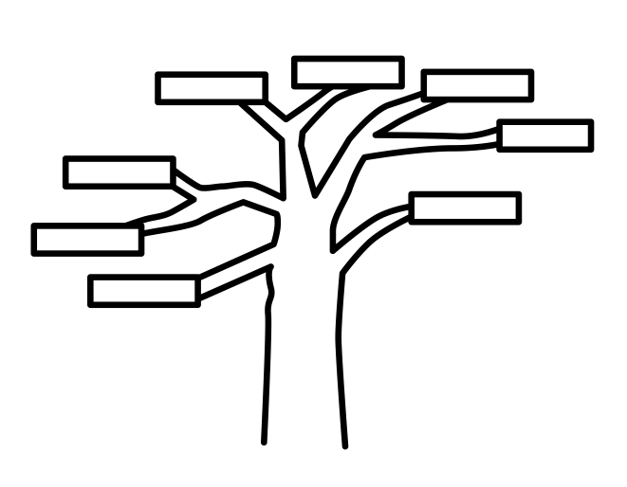
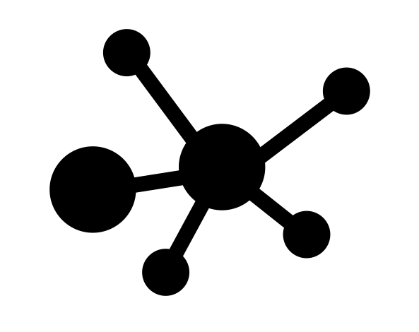
What do we need?
Search based
Where is the table/dashboard for X? What does it contain?
Does this analysis already exist?
Other requirements

Slide 21
What do we need?
Search based | Lineage based
Where is the table/dashboard for X? What does it contain? | I am changing a data model, who are the owner and most common users?
Does this analysis already exist? | This table’s delivery was delayed today, I want to notify everyone downstream.
Other requirements

Slide 22
What do we need?
Search based | Lineage based | Network based
Where is the table/dashboard for X? What does it contain? | I am changing a data model, who are the owner and most common users? | I want to follow a power user in my team.
Does this analysis already exist? | This table’s delivery was delayed today, I want to notify everyone downstream. | I want to bookmark tables of interest and get a feed of data delay, schema change, incidents.
Other requirements
Leverage as much data automatically as possible
Preferably, open source and healthy community
API availability
Easy to set up

Slide 23


What’s out there?
Criteria / Products | Alation | WhereHows | Airbnb Data Portal | Cloudera Navigator | Apache Atlas
Search based
Lineage based
Network based
Hive/Presto support
Redshift support
Open source (pref.)

Slide 24
Important things for the journey
Trust embodied in the solution itself
Sort results in order of relevance and popularity

Slide 25
Important things for the journey
Trust embodied in the solution itself
Sort results in order of relevance and popularity
Very low amount of manual curation
Automated curation as much as possible

Slide 26
Important things for the journey
Trust embodied in the solution itself
Sort results in order of relevance and popularity
Very low amount of manual curation
Automated curation as much as possible
Slight preference for open source
Driving the OS community forward with this new tool

Slide 27
Important things for the journey
Trust embodied in the solution itself
Sort results in order of relevance and popularity
Very low amount of manual curation
Automated curation as much as possible
Slight preference for open source
Driving the OS community forward with this new tool
Targeted user experience not available in other tools

Slide 28


Slide 29
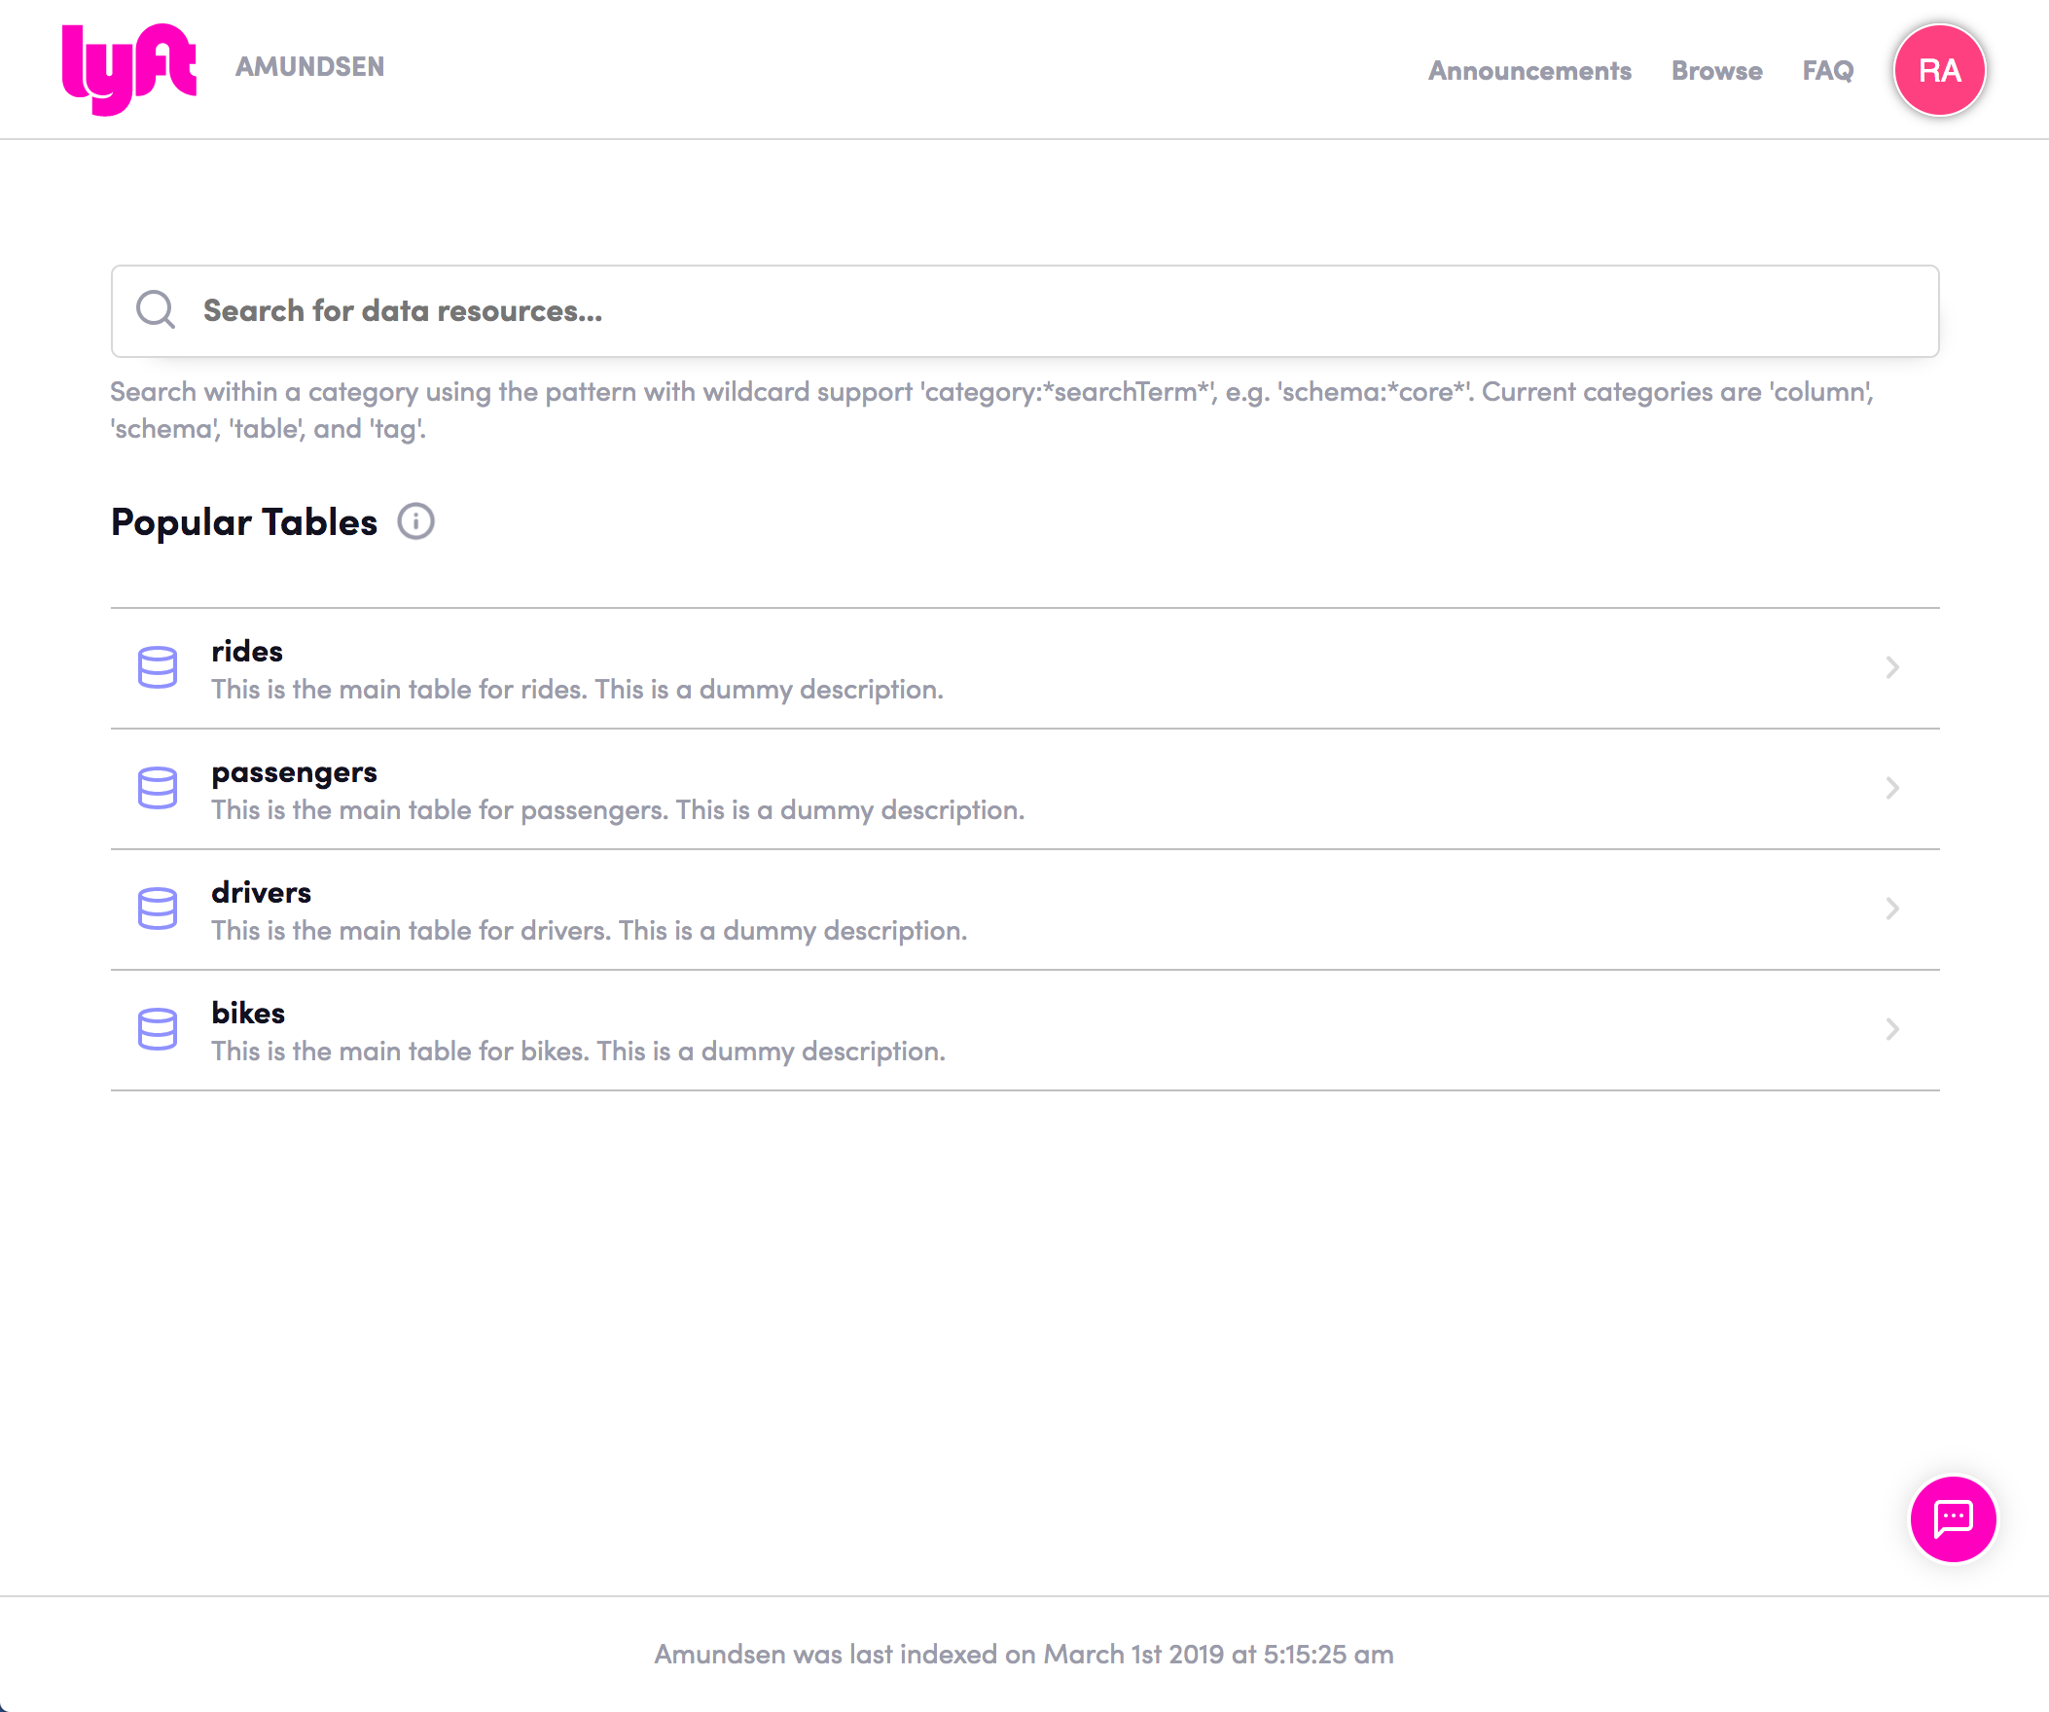
Amundsen - landing page

Slide 30
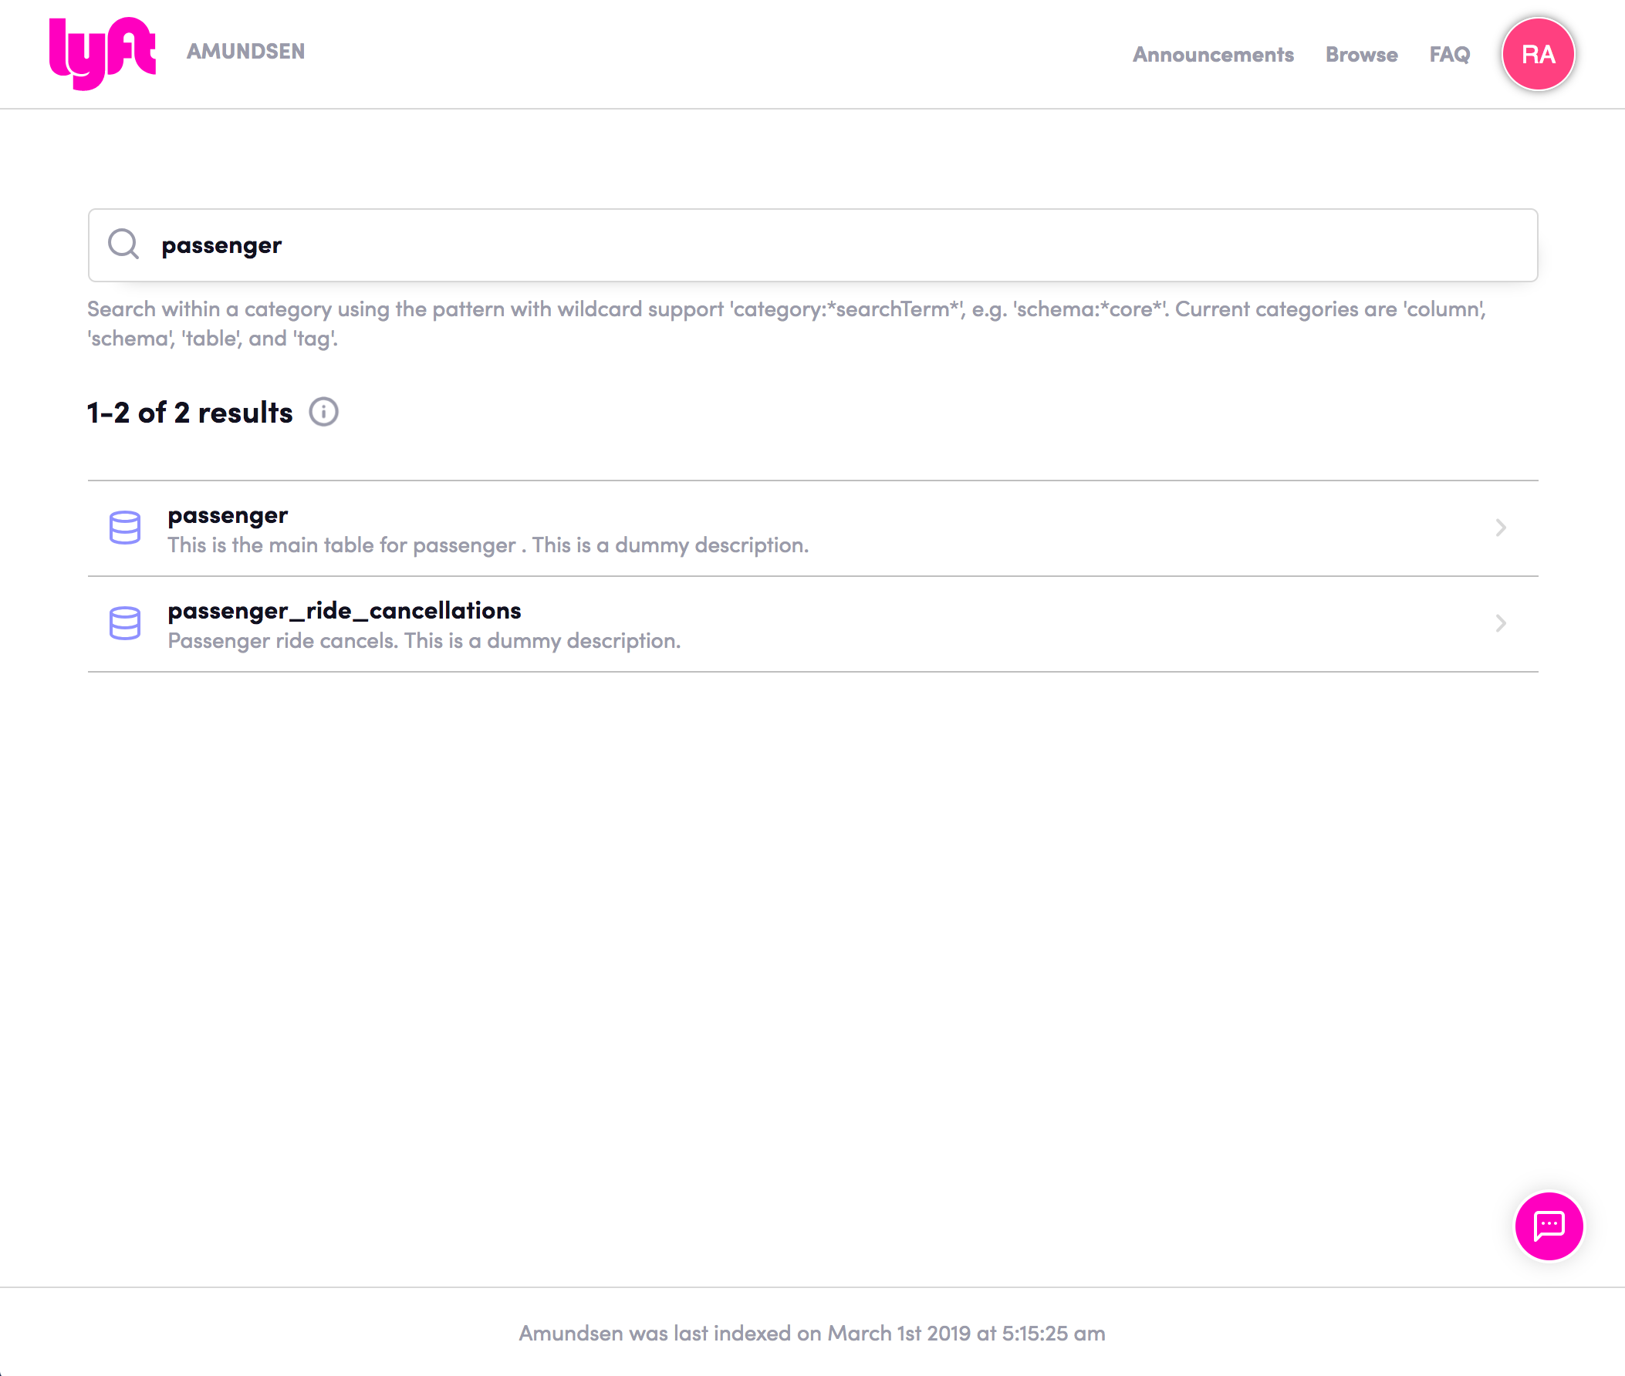
Amundsen - search

Slide 31
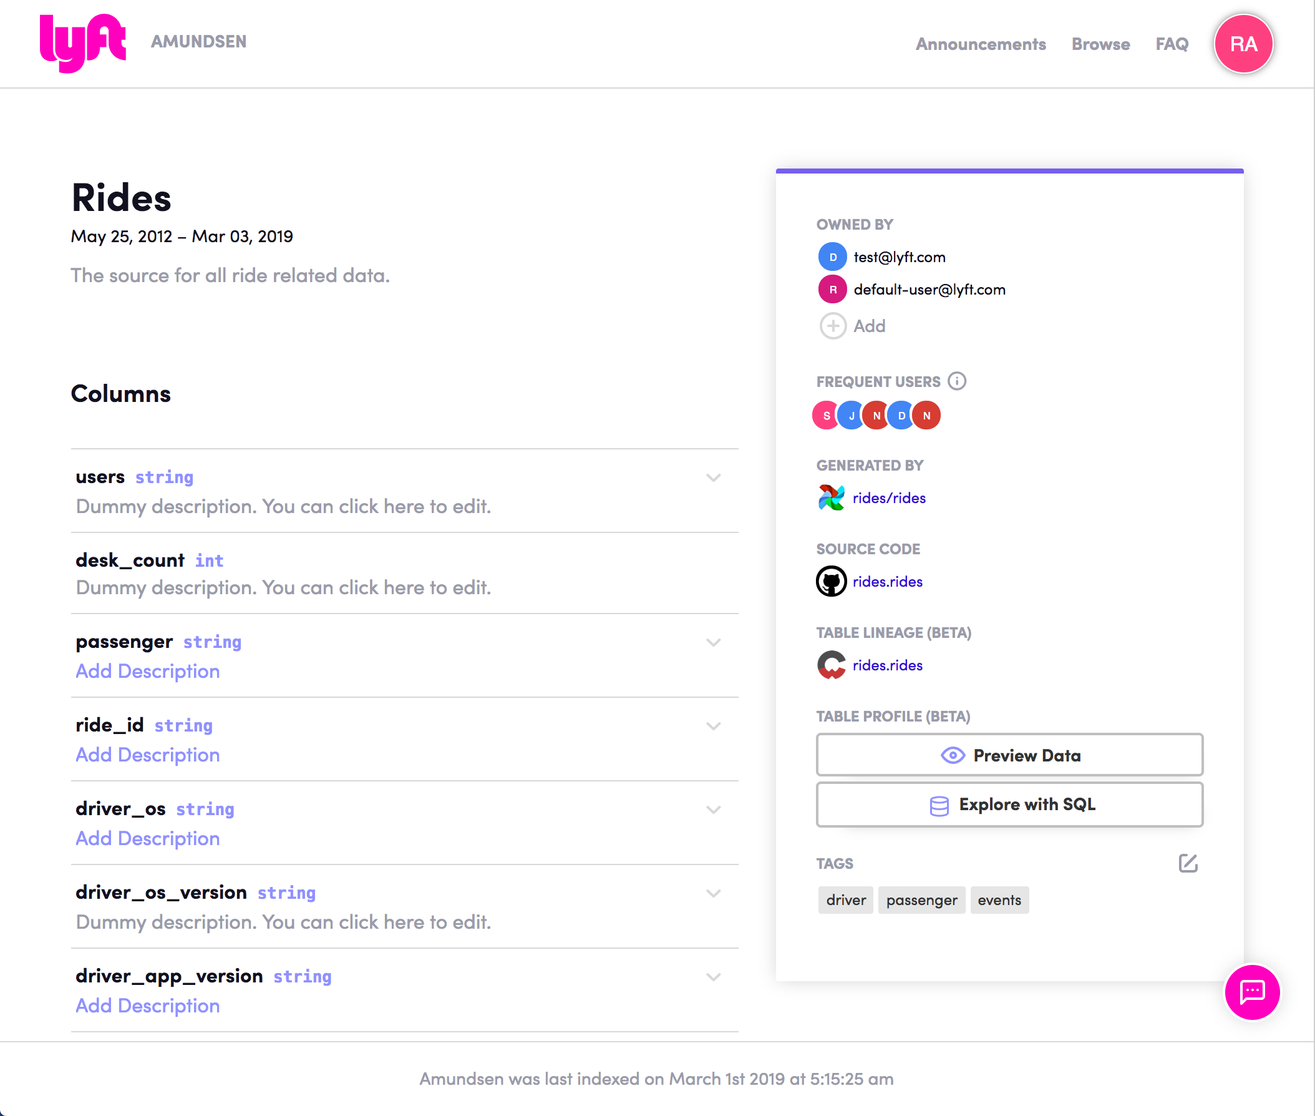
Amundsen - table detail page

Slide 32
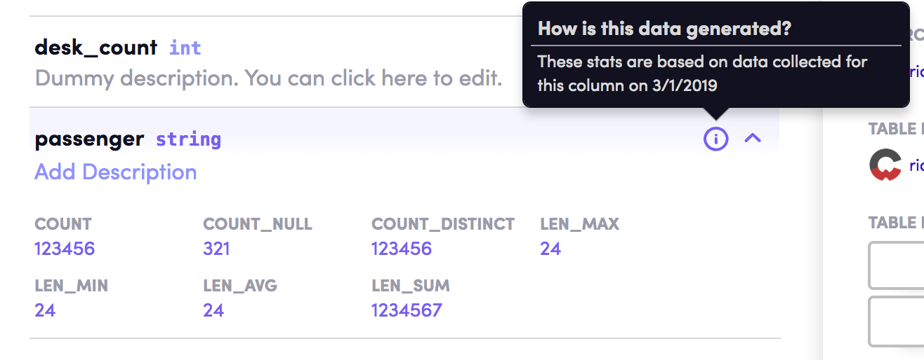
Amundsen - column details

Slide 33
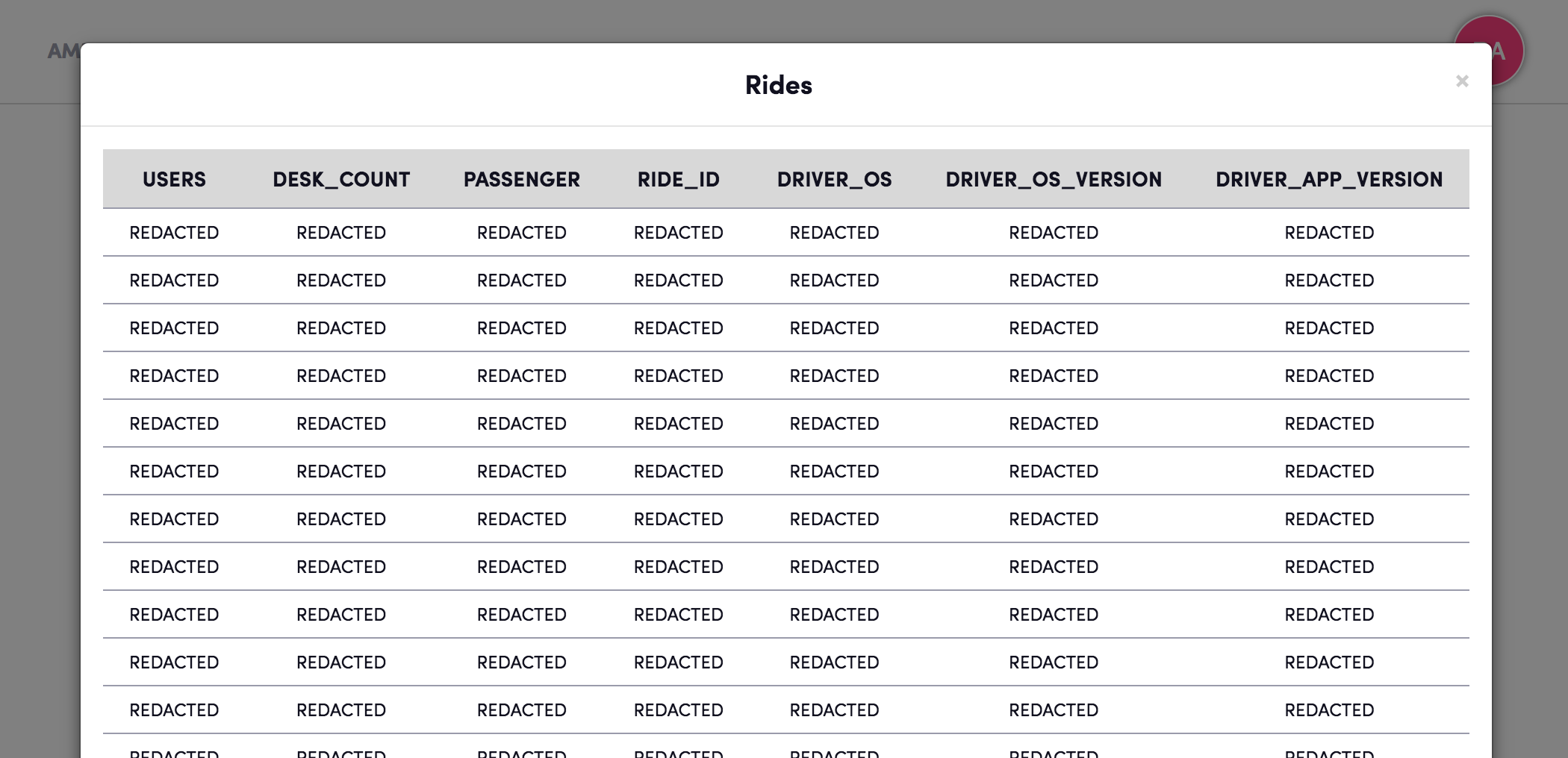
Amundsen - preview

Slide 34
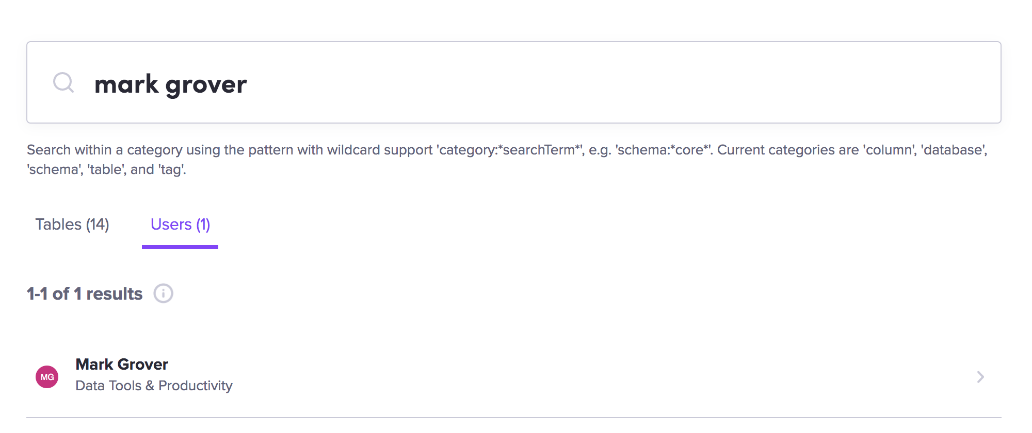
Amundsen - people search

Slide 35
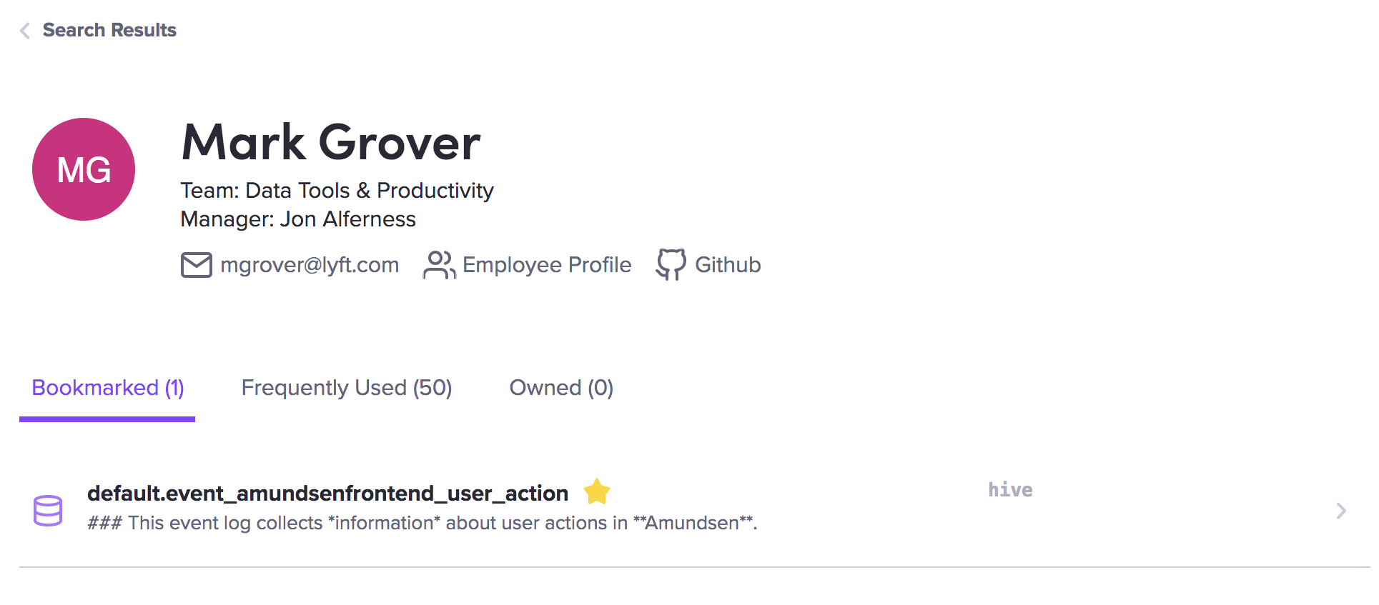
Amundsen - people page

Slide 36


Slide 37
Amundsen services working together
Other Microservices
Frontend Service
ML Feature Service
Security Service
Metadata Service
Search Service
Neo4j
Elastic
Search
Databuilder Crawler
Metadata Sources
Postgres
Hive
Redshift
...
Presto
Github Source File

Slide 38
Amundsen services working together
Other Microservices
Frontend Service
ML Feature Service
Security Service
Metadata Service
Search Service
Neo4j
Elastic
Search
Databuilder Crawler
Metadata Sources
Postgres
Hive
Redshift
...
Presto
Github Source File

Slide 39
Amundsen services working together
Other Microservices
Frontend Service
ML Feature Service
Security Service
Metadata Service
Search Service
Neo4j
Elastic
Search
Databuilder Crawler
Metadata Sources
Postgres
Hive
Redshift
...
Presto
Github Source File

Slide 40
Amundsen services working together
Other Microservices
Frontend Service
ML Feature Service
Security Service
Metadata Service
Search Service
Neo4j
Elastic
Search
Databuilder Crawler
Metadata Sources
Postgres
Hive
Redshift
...
Presto
Github Source File

Slide 41
Amundsen services working together
Other Microservices
Frontend Service
ML Feature Service
Security Service
Metadata Service
Search Service
Neo4j
Elastic
Search
Databuilder Crawler
Metadata Sources
Postgres
Hive
Redshift
...
Presto
Github Source File

Slide 42
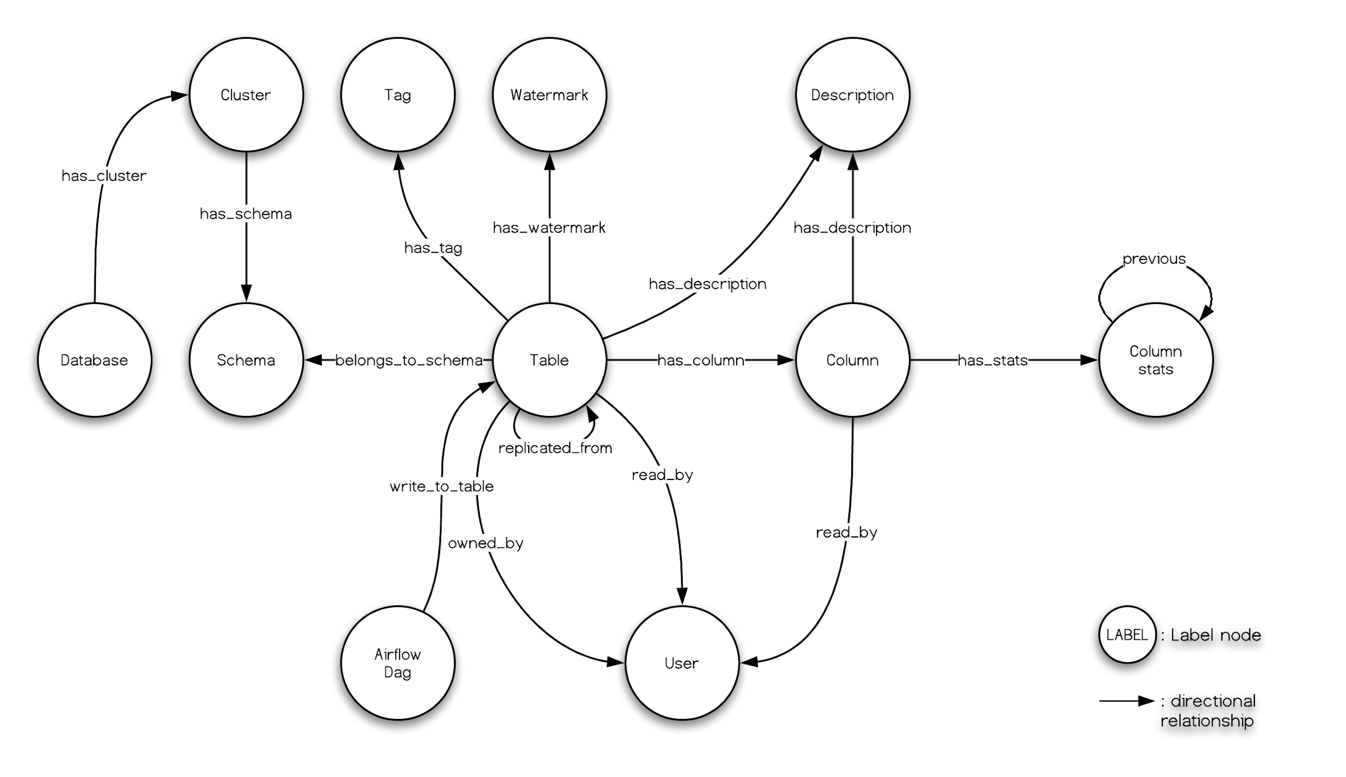
Relations rather than entities

Slide 43
SQL vs Neo4J queries
SQL | Cypher (Neo4j)
SELECT firstname FROM person WHERE person.nickname= 'The Dude' | MATCH p:person WHERE p.nickname= 'The Dude' RETURN p.firstname

Slide 44
SQL vs Neo4J queries
SQL | Cypher (Neo4j)
SELECT firstname FROM person WHERE person.nickname= 'The Dude' | MATCH p:person WHERE p.nickname= 'The Dude' RETURN p.firstname
SELECT firstname,team.name FROM person JOIN team ON person.teamid = team.id WHERE person.nickname= 'The Dude' AND team.sport = 'Bowling' | MATCH (p:person)-[:in]-(t:team) WHERE p.nickname= 'The Dude' AND t.sport = 'Bowling' RETURN p.firstname, t.name

Slide 45
SQL vs Neo4J queries
SQL | Cypher (Neo4j)
SELECT firstname FROM person WHERE person.nickname= 'The Dude' | MATCH p:person WHERE p.nickname= 'The Dude' RETURN p.firstname
SELECT firstname,team.name FROM person JOIN team ON person.teamid = team.id WHERE person.nickname= 'The Dude' AND team.sport = 'Bowling' | MATCH (p:person)-[:in]-(t:team) WHERE p.nickname= 'The Dude' AND t.sport = 'Bowling' RETURN p.firstname, t.name
 | MATCH (p:person)-[*]-(p2:person) WHERE p.nickname= 'The Dude' RETURN p.firstname, p2.firstname

Slide 46
ElasticSearch for search and relevance
Normal search: match records based on relevancy
Category search: match records first based on data type, then relevancy
column: warehouse_cost
Wildcard search:
event_*

Slide 47
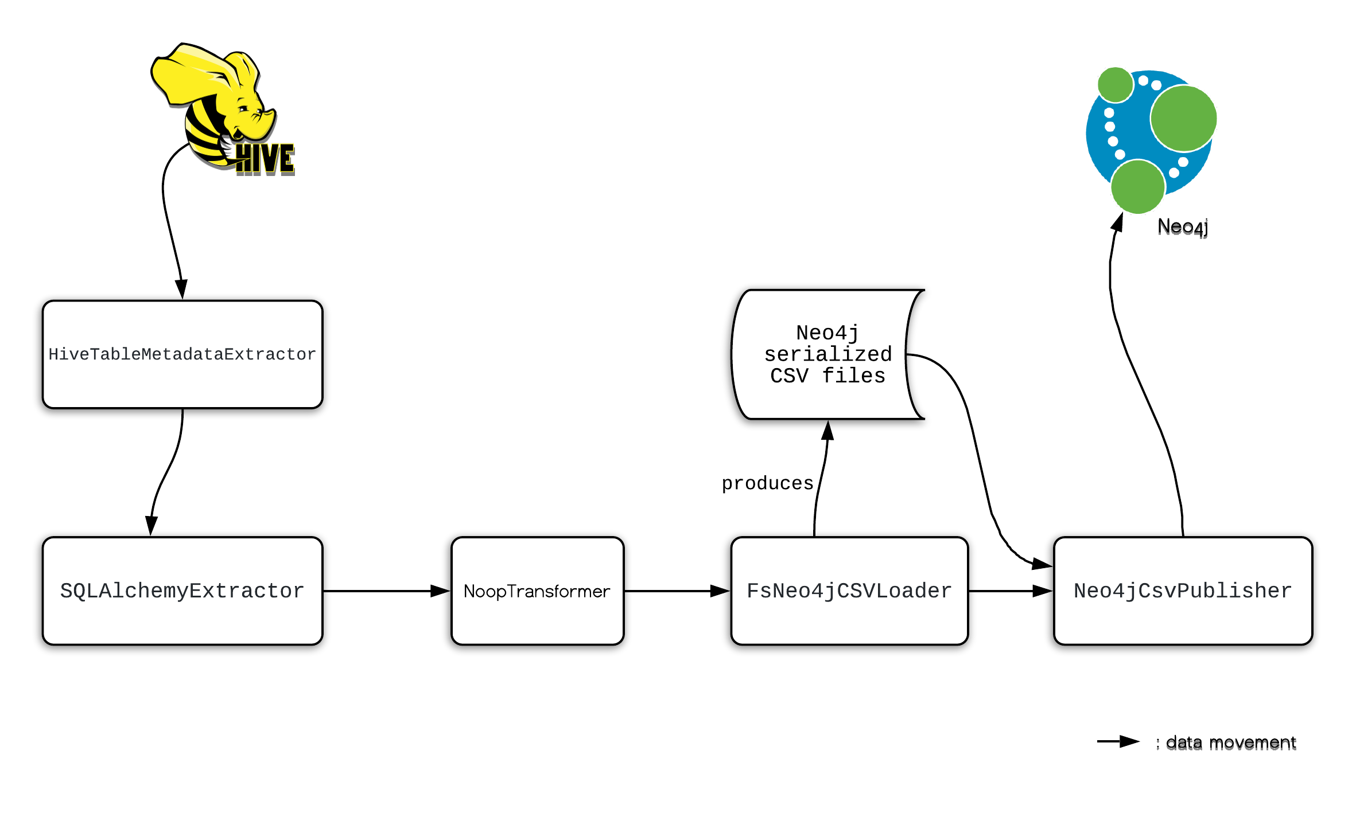
Metadata extractors

Slide 48

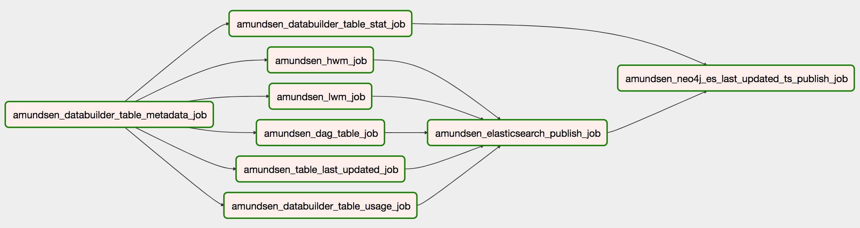
Scheduling extractor jobs ⇒ airflow
Amundsen uses Apache Airflow to orchestrate Databuilder jobs

Slide 49


Slide 50
What to expect...
Customizing UI (logo, colors, etc.)

Slide 51
What to expect...
Customizing UI (logo, colors, etc.)
Security / OpenID Connect for authentication

Slide 52
What to expect...
Customizing UI (logo, colors, etc.)
Security / OpenID Connect for authentication
Look at available extractors:
Hive, BigQuery, Athena, Snowflake, Postgres

Slide 53
What to expect...
Customizing UI (logo, colors, etc.)
Security / OpenID Connect for authentication
Look at available extractors:
Hive, BigQuery, Athena, Snowflake, Postgres
Build your dags

Slide 54


Slide 55
Roadmap
UI/UX redesign
Email notifications system
Indexing dashboards
Lineage integration
Granular access level control
More metadata sources
Indexing services and teams

Slide 56
From Discovery towards Governance
Data Discovery
Compliance (GDPR/CCPA)
Data Quality
Downstream impact analysis
. . . . .
Metadata

Slide 57












































Other users
Prominent users
Active community
‹#›

Slide 58
Where to go for more
https://www.github.com/lyft/amundsen
amundsenworkspace.slack.com #amundsen @ slack
(link on github page)

Slide 59

Join at slido.com with #bigdata2019
Gerard Toonstra| Data Discovery with Amundsen | 27-11-2019 | https://www.careersatcoolblue.com

